Slide 1

UML Class and Object Diagram
Dr Rami Bahsoon
School of Computer Science,
University of Birmingham, UK
r.bahsoon@bham.ac.uk

Slide 2
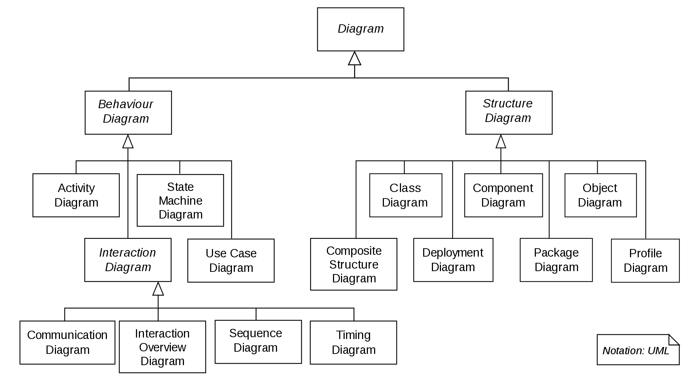
UML 2.X
UML 2.X
Collaboration Diagram

Slide 3
Class Diagram
Keep in mind:
Use Cases represent an external view of the system’s behavior
Classes represent inner structure of the system
No correlation between use cases and classes
Class diagrams are used at different levels of abstraction with different levels of details
Early design phase: identifying classes and their relations in the problem domain (high-level, no implementation details)
Implementation phase: high level of detail (attributes, visibility, …), all classes relevant to implement the system

Slide 4
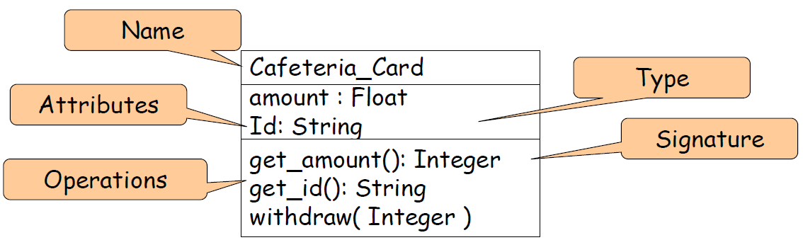
Class Icon
A class encapsulates state (attributes) and behavior (operations)
Each attribute has a type
Each operation has a signature
The class name is the only mandatory information

Slide 5
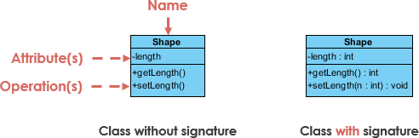
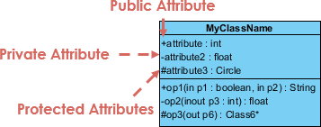
Classes Visibility
The return type of a method is shown after the colon at the end of the method signature.
The type of method arguments are shown after the colon following the parameter name.
Class Visibility
The +, - and # symbols denote the visibility of the attribute and operation.
+ public: public members can be accessed by any client of the class
# protected: protected members can be accessed by members of the class or any subclass
- private: private members can only be accessed by members of the same class

Slide 6
Class Analysis: How to Derive Classes?
Class analysis abstracts one or more classes and/or subsystems in the design
Focuses on handling functional requirements
Defines responsibilities (cohesive subsets of behavior defined by the class)
Defines attributes
Expresses relationships the class is involved in with other classes.

Slide 7
Approach 1: Data-Driven Design
Identify all the data in the system
• Divide into classes before considering responsibilities
• Common approach: noun identification
Identify candidate classes by selecting all the nouns and noun phrases in the requirements document
Discard inappropriate candidates
» Redundant or omnipotent entities
» Vague entities
» Events or operations
» Meta-language
» Entities outside system scope
» Attributes
Verbs and verb phrases highlight candidate operations!

Slide 8
Approach 1: Data-Driven Design
Some heuristics of what kind of things are classes [Shlaer and Mellor; Booch]…
Tangible or “real-world” things – book, copy, course;
Roles- library member, student, director of studies,
Events- arrival, leaving, request;
Interactions- meeting, intersection

Slide 9
Exercise
Perform noun-verb analysis of your requirements document;
Underline all the noun and noun phrases,
Create a list of candidate classes (in examining the discard criteria, you may also identify some candidate attributes)
Identify all verb and verb phrases
Create a list of candidate operations and assign them to classes

Slide 10
Noun/Verb Analysis

Slide 11
Noun/Verb Analysis: Another Example
Withdrawing –
One of these transactions is withdraw-transaction allowing customers to withdraw money. The system displays a number of money amounts (£10, £20, £30 or £50) which the customer can select from; alternatively a customer can supply their own desired amount instead. The system then validates the chosen amount by ensuring that the amount is greater or equal to £10, but is less than £250 per day and that the amount is a multiple of £10. When the amount is chosen the customer’s account is checked for sufficient funds. If the customer has sufficient funds the system displays the new account balance and a cash dispenser counts the required money, places the money in the money tray and then opens the money tray, once the customer has removed the money the cash dispenser closes the money tray. The customer is then asked if they require a receipt to be printed in A4 or printed in A5, for this the system has a receipt printer which can print a receipt by setting the receipt paper size and setting the receipt information. Afterwards they are returned to the main menu or alternatively if they don’t have enough funds the system displays an insufficient funds message and they are returned to the main menu. For all parts of this functionality there is an option to display information that explains what operations can be done.

Slide 12
Noun/Verb Analysis: Another Example
Withdrawing –
One of these transactions is withdraw-transaction allowing customers to withdraw money. The system displays a number of money amounts (£10, £20, £30 or £50) which the customer can select from; alternatively a customer can supply their own desired amount instead. The system then validates the chosen amount by ensuring that the amount is greater or equal to £10, but is less than £250 per day and that the amount is a multiple of £10. When the amount is chosen the customer’s account is checked for sufficient funds. If the customer has sufficient funds the system displays the new account balance and a cash dispenser counts the required money, places the money in the money tray and then opens the money tray, once the customer has removed the money the cash dispenser closes the money tray. The customer is then asked if they require a receipt to be printed in A4 or printed in A5, for this the system has a receipt printer which can print a receipt by setting the receipt paper size and setting the receipt information. Afterwards they are returned to the main menu or alternatively if they don’t have enough funds the system displays an insufficient funds message and they are returned to the main menu. For all parts of this functionality there is an option to display information that explains what operations can be done.

Slide 13
Noun/Verb List
Word/Phrase | Accepted | Reason
SmartBank | No | Company rather than about the system itself.
Withdraw-transaction | Withdraw | This can be used for a class representing a withdraw transaction
Allowing customers to withdraw money | No | Too general to be a method
System | No | Duplicate
Displays a number of money amounts | displayMoneyAmounts | This is a particular action of the withdraw transaction and hence becomes a method.
Customer | No | Duplicate
Select | No | Too general to be a method
Customer | No | Duplicate
Supply their own desired amount | supplyMoneyAmount | This is a particular action of the withdraw transaction and hence becomes a method.
… | … | …

Slide 14
Approach 2: Responsibility-Driven Design
Identify all the responsibilities in the system
Divide into classes before considering the classes’ data
Common approach: CRC cards
Class, Responsibilities, Collaborations

Slide 15
Responsibility-Driven Design
A CRC card is an index card with three parts:
Class -- name goes at the top of the card
Responsibilities -- as a list on the left side of the card
Collaborators -- as a list on the right side of the card
Class Name (One card per class)
Responsibility | Collaborator
Something that the class knows (keeps track of) or does These should be the high-level responsibilities. Not trying to list out all member functions here. | Another class that the current class has to work with to complete its responsibilities Could be a class that has information we need Could be a class that helps perform a task Typically, we list a class as a collaborator if the current class needs to call upon it to help complete our own responsibilities.

Slide 16
CRC Card Example

Slide 17
noun/verb analysis vs. CRC card
• noun/verb analysis: Identify all the data in the system and divide into classes, before considering responsibilities
CRC card: Identify all the responsibilities in the system and divide into classes before considering the classes’ data

Slide 18
Exercise
Perform responsibility-driven analysis for the system to identify potential classes:
Look at the requirements document and use cases
Identify the candidate classes
Derive your CRC (i.e., Class, Responsibility, and collaborators)

Slide 19
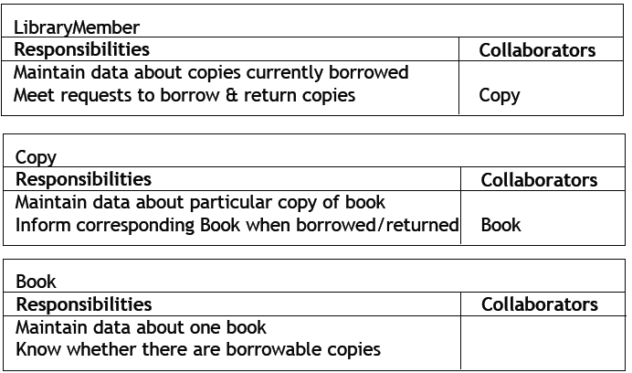
Example CRC Cards for a Library

Slide 20
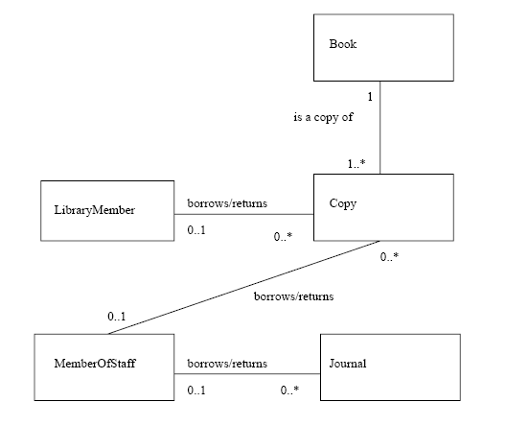
First-Cut Class Diagram (class model)

Slide 21
Relationships
Relationships are connections between modeling elements
Improve understanding of the domain, describing how objects
work together
Act as a sanity check for good modeling
• Associations are relationships between classes
Examples
» Object of class A sends a message to object of class B
» Object of class A creates an object of class B
» Object of class A has attribute whose values are objects of class B
» Object of class A receives a message with argument of class B
• Links are relationships between objects
Links can be instances of associations (as in UML 1.4)
Allow one object to invoke operations on another object

Slide 22
UML Relationship Notation

Slide 23
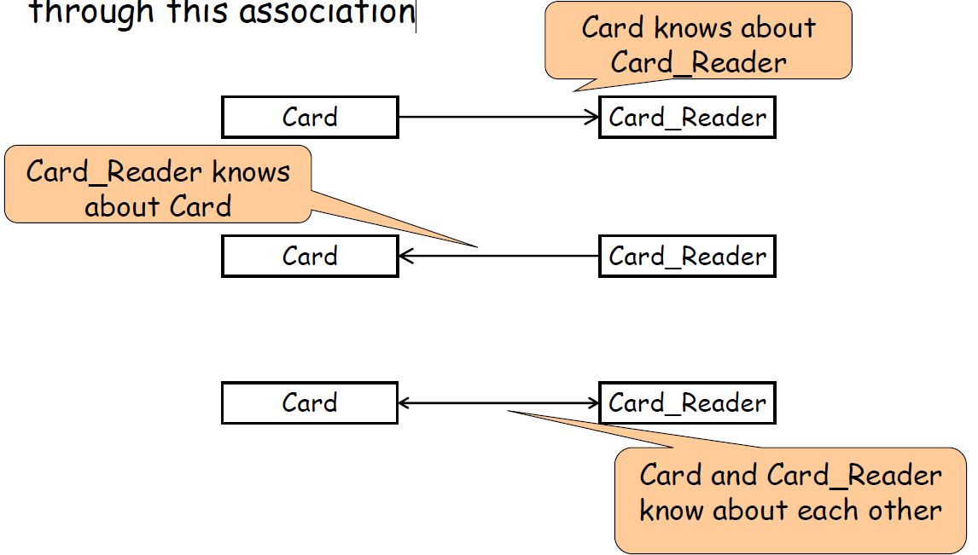
Navigability of Association
Associations can be directed
Direction denotes whether objects can be accessed through this association

Slide 24
Association Multiplicity
Multiplicity denotes how many objects of the class take part in the relation.
1-to-1
1-to-many
many-to-many

Slide 25
Links Instantiate Associations

Slide 26
Multiplicity of an Association

Slide 27
Generalisation and Inheritance

Slide 28
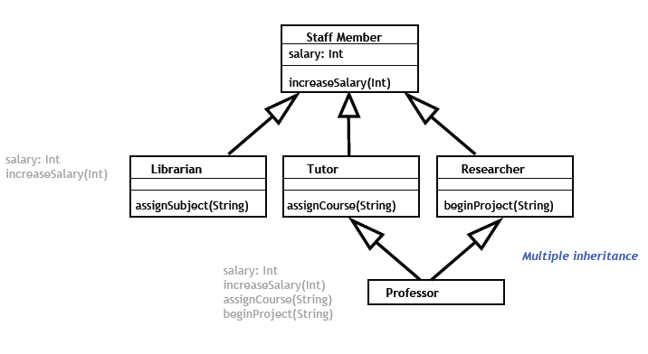
Another Inheritance Example

Slide 29
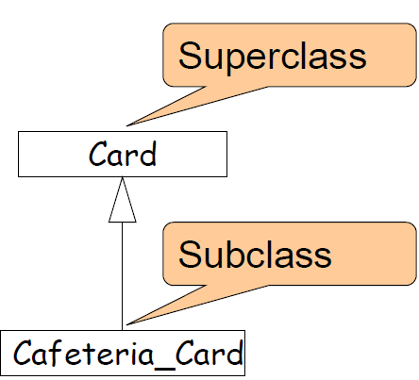
Class-Level Relationships: Generalization and Specialization
Generalization expresses a kind-of (“is-a”) relationship
Generalization is implemented by inheritance
The child classes inherit the attributes and operations of the parent class
Generalization simplifies the model by eliminating redundancy
Solid arrow line

Slide 30
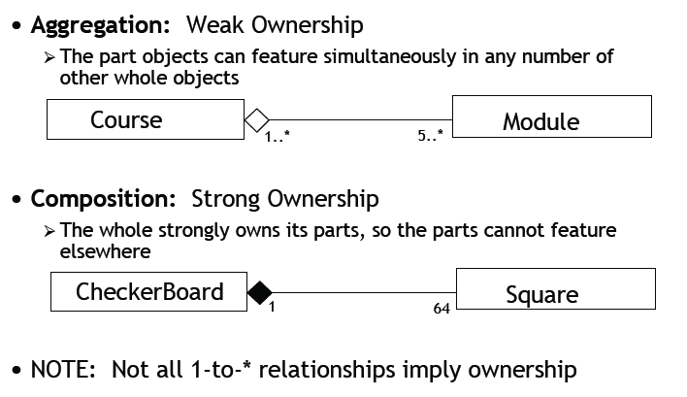
Part/Whole Associations
A module is part of a course
In fact,
5 or more modules are part of one or more courses

Slide 31
Part/Whole Associations
Composed of 64 squares

Slide 32
Special Associations: Aggregation and Composition
Course
Instructor
?
Car
Engine
?

Slide 33
Special Associations: Aggregation and Composition
Course
Instructor
Aggregation
Car
Engine
Composition

Slide 34
Association Classes
Used to attach attributes to an association itself rather than the classes it associates
Class association line must have the same name!

Slide 35
Example: Class Model

Slide 36
Another Example: Class Model

Slide 37
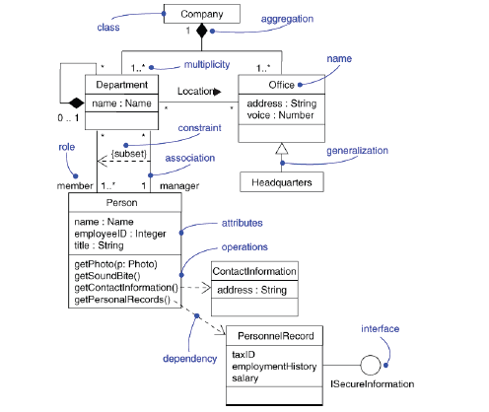
Example: Class Diagram

Slide 38
A Proper Class Diagram Example (detailed)

Slide 39
Specifying Good Classes/Objects
Completeness and convenience
Consistency
Strong cohesion
Loose coupling

Slide 40
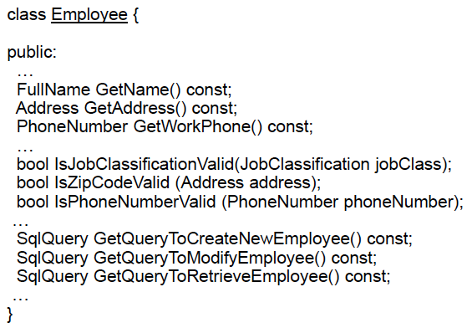
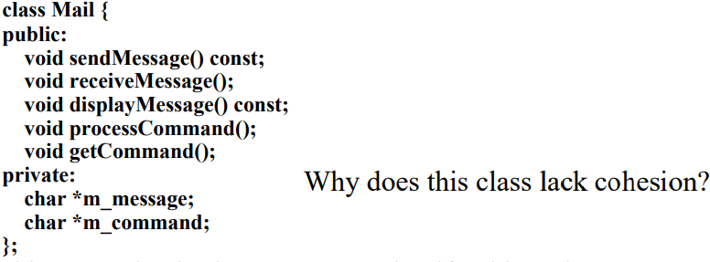
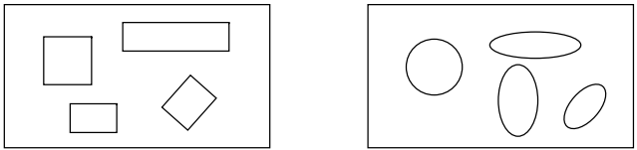
Cohesion
Cohesion is a qualitative measure of the focus or unity of purpose within a single class.
Tight relationships improve clarity and understanding.
A good class describes a single abstraction.
Mail
-m_message
-m_command
+sendMessage()
+receiveMessage()
+displayMessage()
+processCommand()
+getCommand()

Slide 41

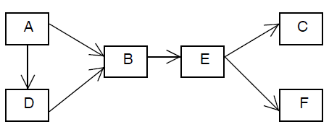
Coupling
Coupling is a qualitative measure of how closely the classes in a design class diagram are linked.
Classes with many interconnections are highly coupled.
E could be an interface.
Using interface improves loose coupling.
easier to understand and maintain

Slide 42
Reduce Coupling
Encapsulation reduces coupling, and use interfaces.
Avoid passing a great amount of data across object boundaries.
Put all responsible objects together for accomplishing a specific work without looking into their detailed processed data.

Slide 43
UML 2.X
UML 2.X
Collaboration Diagram

Slide 44
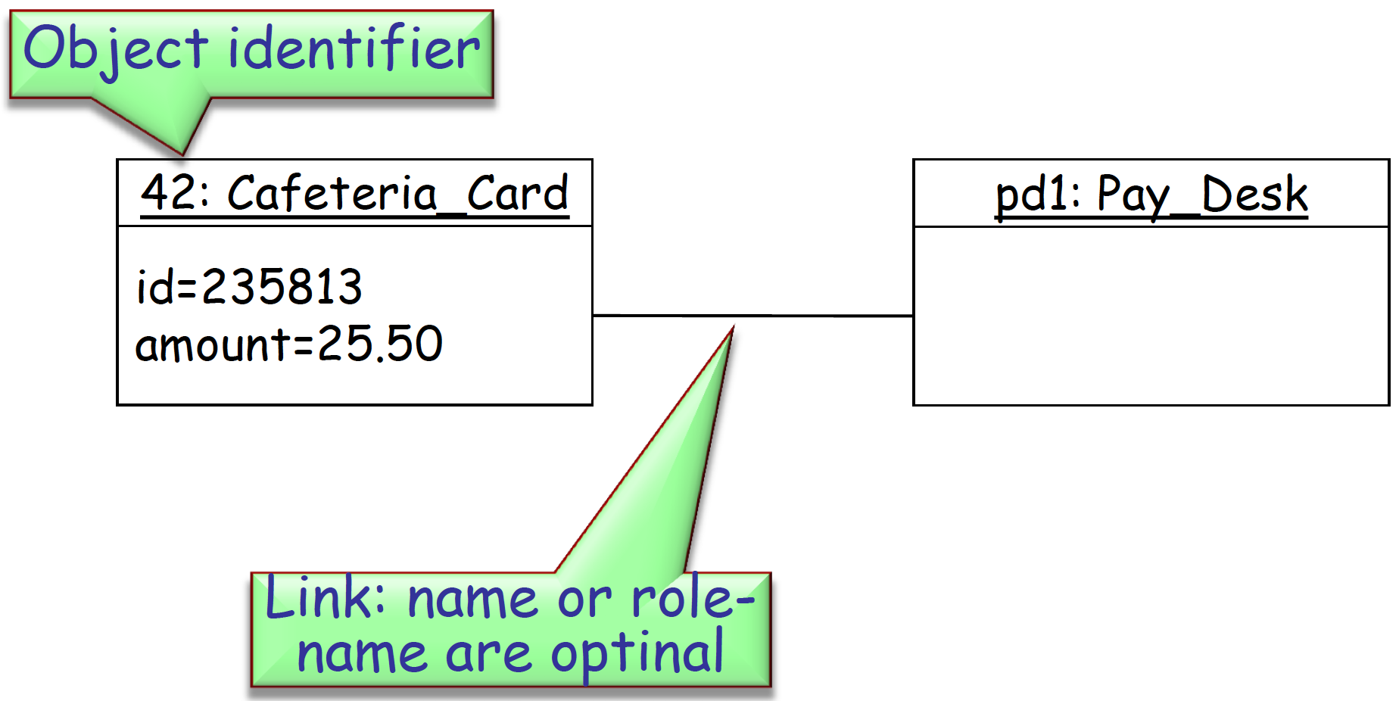
Object Diagram
An Object diagram is used to denote a snapshot of the system at runtime, and developed by analysts, designers and implementers.
It shows the existing objects, their attribute values and relations at that particular point of time

Slide 45
Object Icons

Slide 46
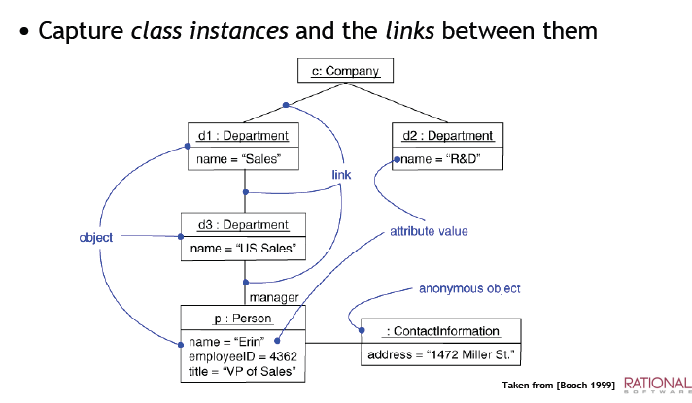
Object Diagram

Slide 47
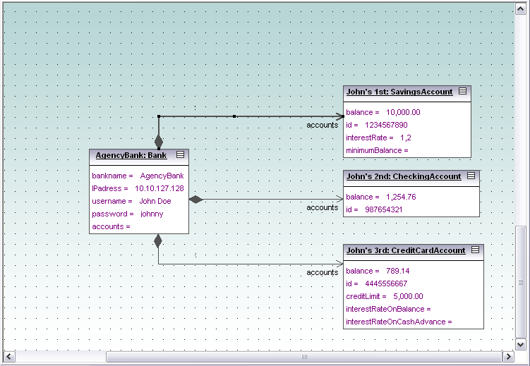
Example

Slide 48
When to Use Object Diagrams
A class diagram defines a structure precisely, but sometimes it can be difficult to understand.
A couple of object diagram examples can help very the class structure.
Built during analysis & design
Illustrate data/object structures
Specify snapshots
Developed by analysts, designers and implementers, and can be used by testers

Slide 49
Tools for Drawing UML Diagrams
Pen and paper
Free online tools, e.g. draw.io
Desktop app, e. g Microsoft visio
Violet (free): http://horstmann.com/violet/
UMLet (free): https://www.umlet.com/
Visual Paradigm UML Suite (trial): http://www.visual-paradigm.com/
Demo: IBM Rational Software Architect UML Samples: https://www.ibm.com/support/knowledgecenter/SS5JSH_9.1.1/com.ibm.rsart.nav.doc/com.ibm.rsart.nav.doc_eclipse-gentopic18.html
Other reference: https://sparxsystems.com/resources/links.html

